Slide 1
MongoDB
3APIS

Slide 2
3APIS – MongoDB
Course Objectives
By the end of the course, students should:
Learn about NoSQL
Know how to use MongoDB
Understand when to choose SQL or NoSQL
Integrate MongoDB to an Express.js API

Slide 3
Summary
SQL / NoSQL
MongoDB
Express.js

Slide 4
1. SQL / NoSQL

Slide 5
1. SQL / NoSQL
SQL, or Structured Query Language, is a standard programming language designed for managing and manipulating relational databases.
It serves as the foundation for interacting with relational database management systems (RDBMS), such as MySQL, PostgreSQL, SQLite, and Microsoft SQL Server.
SQL provides a standardized way to define, query, update, and manage relational databases.

Slide 6
1. SQL / NoSQL
Structured data model
SQL databases follow a structured, tabular data model where data is organized into tables with predefined schemas.
Each table consists of rows and columns, and relationships between tables are established through keys.

Slide 7
1. SQL / NoSQL
ACID properties
SQL databases adhere to ACID (Atomicity, Consistency, Isolation, Durability) properties, ensuring transactions are reliably processed and maintain data integrity.

Slide 8
1. SQL / NoSQL
Schema
A predefined schema dictates the structure of the database, specifying the data types, relationships, and constraints for each table.
Any changes to the schema often require careful planning and migration processes.

Slide 9
1. SQL / NoSQL
Scalability challenges
Traditional SQL databases may face challenges when scaling horizontally due to their rigid structure and complex relationships.

Slide 10
1. SQL / NoSQL
NoSQL databases represent a diverse category of database management systems that depart from the traditional relational model.
The term "NoSQL" doesn't imply a lack of SQL language support but rather a departure from the structured, tabular nature of SQL databases.

Slide 11
1. SQL / NoSQL
Flexible schema
NoSQL databases allow for dynamic and flexible schema design, enabling developers to work with unstructured or semi-structured data.
This flexibility is advantageous in scenarios where data models evolve rapidly.

Slide 12
1. SQL / NoSQL
Variety of models
NoSQL databases come in various models, including document-oriented (e.g., MongoDB), key-value stores (e.g., Redis), wide-column stores (e.g., Apache Cassandra), and graph databases (e.g., Neo4j).
Each model is optimized for specific use cases.

Slide 13
1. SQL / NoSQL
BASE properties
NoSQL databases often adhere to the BASE (Basically Available, Soft state, Eventually consistent) model, offering more relaxed consistency guarantees compared to the strict ACID properties of SQL databases.
This approach is suitable for distributed and highly scalable systems.

Slide 14
1. SQL / NoSQL
Horizontal scalability
NoSQL databases are generally more conducive to horizontal scalability, allowing them to handle large volumes of data and traffic by distributing data across multiple nodes or servers.

Slide 15
1. SQL / NoSQL
while SQL and NoSQL databases both serve as valuable tools in the data management landscape, they exhibit distinct characteristics that make them suitable for different types of applications and use cases.
The choice between them depends on factors such as data structure, scalability requirements, and development agility.

Slide 16
1. SQL / NoSQL
One last point that is important to emphasis when thinking about SQL and NoSQL
SQL: with a focus on reducing data duplication as storage was much more costly than developer time (when it was created)
NoSQL: Developers (rather than storage) were becoming the primary cost of software development

Slide 17
1. SQL / NoSQL
As storage costs rapidly decreased, the amount of data that applications needed to store and query increased.
This data came in all shapes and sizes — structured, semi-structured, and polymorphic — and defining the schema in advance became nearly impossible.
NoSQL databases allow developers to store huge amounts of unstructured data, giving them a lot of flexibility.

Slide 18
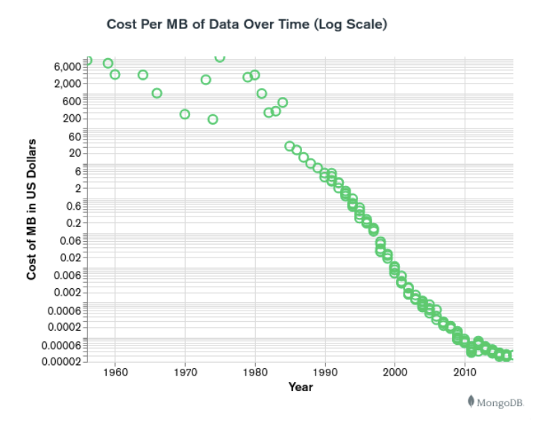
1. SQL / NoSQL

Slide 19
1. SQL / NoSQL
Cloud computing also rose in popularity, and developers began using public clouds to host their applications and data.
They wanted the ability to distribute data across multiple servers and regions to make their applications resilient, to scale out instead of scale up, and to intelligently geo-place their data.
Some NoSQL databases like MongoDB provide these capabilities.

Slide 20
1. SQL / NoSQL
Each NoSQL database has its own unique features. At a high level, many
NoSQL databases have the following features:
Flexible schemas
Horizontal scaling
Fast queries due to the data model
Ease of use for developers
Over time, four major types of NoSQL databases emerged: document
databases, key-value databases, wide-column stores, and graph databases.

Slide 21
1. SQL / NoSQL
Document database
Store data in documents similar to JSON (JavaScript Object Notation) objects
Each document contains pairs of fields and values
The values can typically be a variety of types including things like strings, numbers, booleans, arrays, or objects.
MongoDB & CouchDB

Slide 22
1. SQL / NoSQL
Key-Value database
Are a simpler type of database
Where each item contains keys and values.
Redis & DynamoDB

Slide 23
1. SQL / NoSQL
Wide-column store
Store data in tables, rows, and dynamic columns.
Cassandra & HBase

Slide 24
1. SQL / NoSQL
Graph database
Store data in nodes and edges
Nodes typically store information about people, places, and things
While edges store information about the relationships between the nodes.
Neo4J & Amazon Neptune

Slide 25
1. SQL / NoSQL
NoSQL databases typically have very flexible schemas.
A flexible schema allows you to easily make changes to your database as requirements change. You can iterate quickly and continuously integrate new application features to provide value to your users faster.
Most SQL databases require you to scale-up vertically (migrate to a larger, more expensive server) when you exceed the capacity requirements of your current server.
Conversely, most NoSQL databases allow you to scale-out horizontally,
meaning you can add cheaper, commodity servers whenever you need to.

Slide 26
1. SQL / NoSQL
Queries in NoSQL databases can be faster than SQL databases.
Why? Data in SQL databases is typically normalized, so queries for a single object or entity require you to join data from multiple tables. As your tables grow in size, the joins can become expensive. However, data in NoSQL databases is typically stored in a way that is optimized for queries.
The rule of thumb when you use MongoDB is “data that is accessed together should be stored together”. Queries typically do not require joins, so the queries are very fast.

Slide 27
1. SQL / NoSQL
Some NoSQL databases like MongoDB map their data structures to those of popular programming languages.
This mapping allows developers to store their data in the same way that they use it in their application code. While it may seem like a trivial advantage, this mapping can allow developers to write less code, leading to faster development time and fewer bugs.

Slide 28
1. SQL / NoSQL
Since data models in NoSQL databases are typically optimized for queries and not for reducing data duplication, NoSQL databases can be larger than SQL databases.
Storage is currently so cheap that most consider this a minor drawback, and some NoSQL databases also support compression to reduce the storage footprint.

Slide 29
1. SQL / NoSQL
Depending on the NoSQL database type you select, you may not be able to achieve all of your use cases in a single database.
For example, graph databases are excellent for analyzing relationships in your data but may not provide what you need for everyday retrieval of the data such as range queries.

Slide 30

Exercises

Slide 31
2. MongoDB

Slide 32
2. MongoDB
MongoDB is a widely-used NoSQL database management system that provides a flexible and schema-less approach to data storage.
Developed by MongoDB Inc., it falls under the category of document-oriented databases and is designed to handle large volumes of unstructured or semi-structured data.
MongoDB's name is derived from "humongous," emphasizing its capacity to manage massive amounts of data.

Slide 33
2. MongoDB
MongoDB
is a source-available
cross-platform
document-oriented database program
classified as a NoSQL database program
uses JSON-like documents
developed by MongoDB Inc.
licensed under the Server Side Public License (SSPL).

Slide 34
2. MongoDB
The main features are
Ad-hoc queries
Indexing
Replication
Load balancing
File storage
Aggregation

Slide 35
2. MongoDB
But you will also find that MongoDB is capable of
Server-side JavaScript execution
Capped collections
Transactions
ACID support

Slide 36
2. MongoDB
Now that we saw the basics features let's see how we can operate on the database with the shell or on Atlas
In the next few pages we will see the basics CRUD operation but mongo
provides a lot more. You can check the full documentation

Slide 37
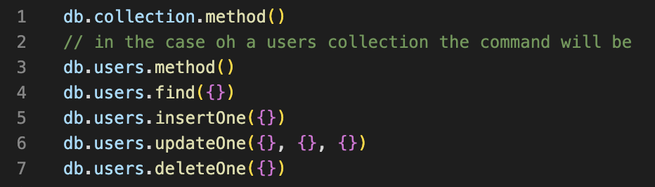
2. MongoDB
All the commands will be based on an users collection.

Slide 38
Exercises

Slide 39
3. Express.js

Slide 40
3. Express.js
There is two main solution to easily use MongoDB in an Express.js
application
use the mongo driver
use the ODM mongoose
In this course we will mainly focus on the usage of mongoose

Slide 41

3. Express.js
To install on or the other package you can do in your terminal
Select the one you want to use (here we will choose mongoose)

Slide 42
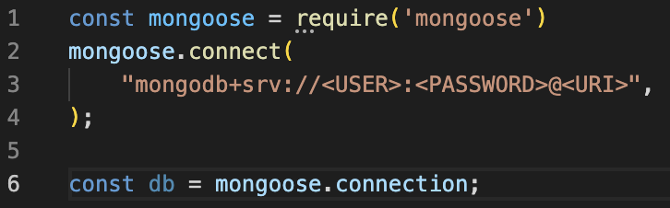
3. Express.js
First of all you need to connect your application to the database to then be able to execute some queries

Slide 43
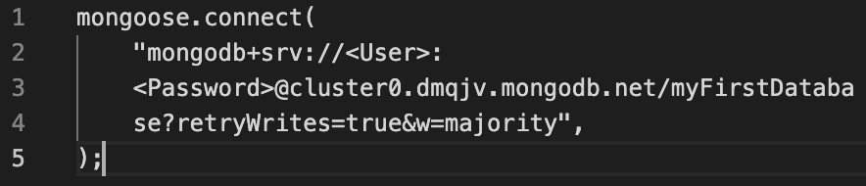
3. Express.js
For example if you use MongoDB Atlas you should have something like that

Slide 44
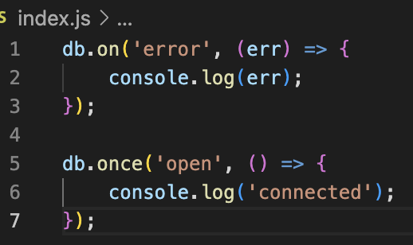
3. Express.js
Some events can be fired to let you know of the state of the connection. The two main event that are used are
error state
open state.

Slide 45
3. Express.js
One the connection is established now you will need to create a schema.
A schema is the solution used by the ODM mongoose to know how to handle the schema of your database but it will also be used to define validation rules or database schema (and update it if necessary)

Slide 46
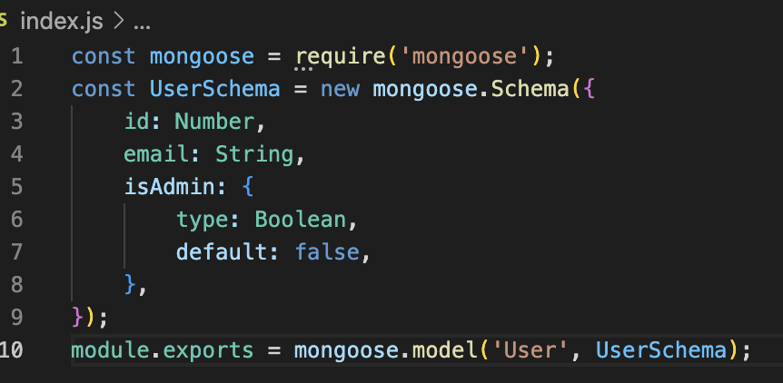
3. Express.js
In another file create a basic schema and export it to be able to use it in
another file

Slide 47
3. Express.js
With that, most of the requests become really simple to execute and as a developer we don't need to work with another language.
Let's see how we can build a basic CRUD
For all examples below we will base a default connection to the database.
For the mongoose use case we will use the previous schema.
For a pure mongodb usage we will have to define our collection

Slide 48
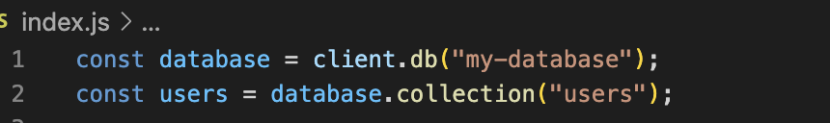
3. Express.js

Slide 49
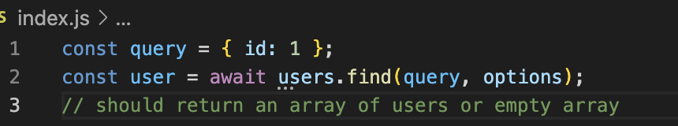
3. Express.js
GET: Mongo

Slide 50
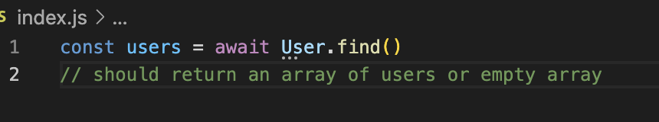
3. Express.js
GET: mongoose

Slide 51
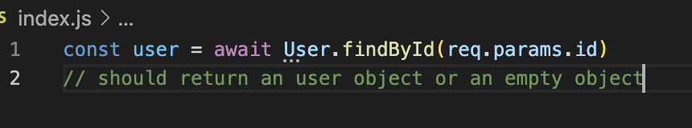
3. Express.js
GET by id: mongoose

Slide 52
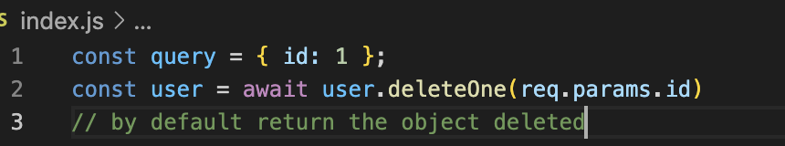
3. Express.js
DELETE: mongo

Slide 53
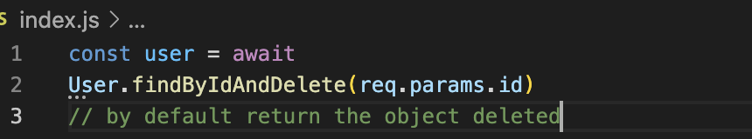
3. Express.js
DELETE: mongoose

Slide 54
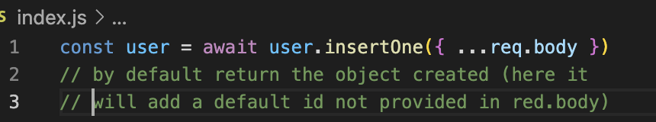
3. Express.js
POST: mongo

Slide 55
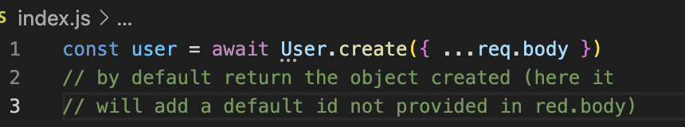
3. Express.js
POST: mongoose

Slide 56
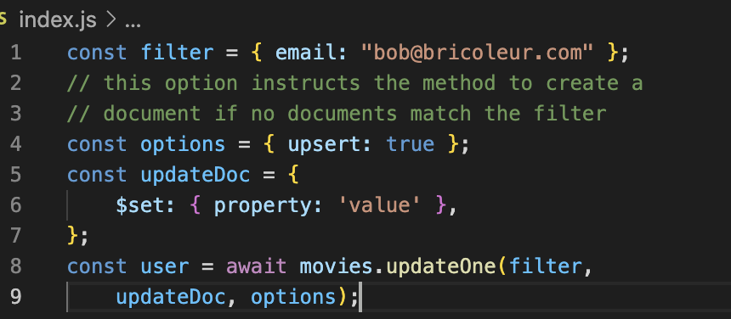
3. Express.js
PUT: mongo

Slide 57
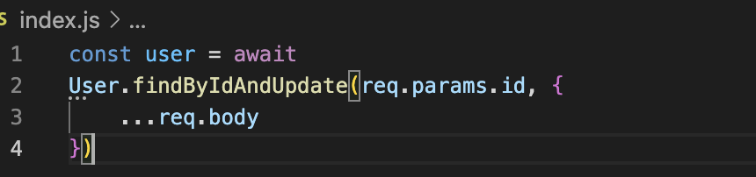
3. Express.js
PUT: mongoose

Slide 58
Exercises

